Slide 1
Data Operations and Management
Name- Pooja Sharma
Roll No- L00171181
Atlantic Technological University

Slide 2

Apache Spark-Next Generation Big Data Framework with Unstructured Data
Analyzing Popular New York Times Articles

Slide 3

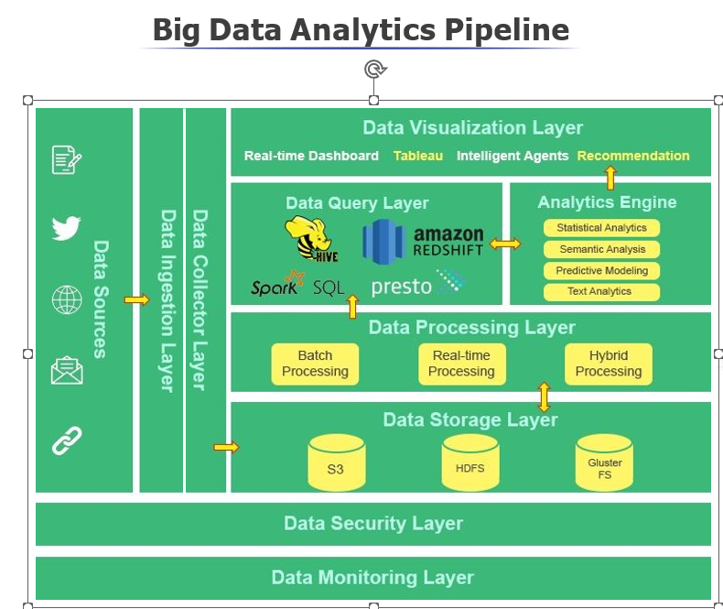

Slide 4

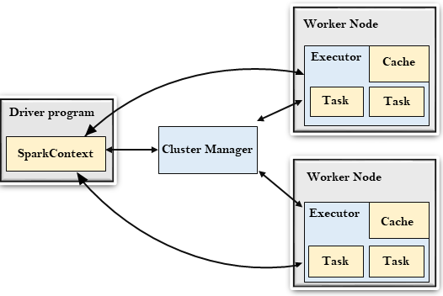



Spark Architecture

Slide 5
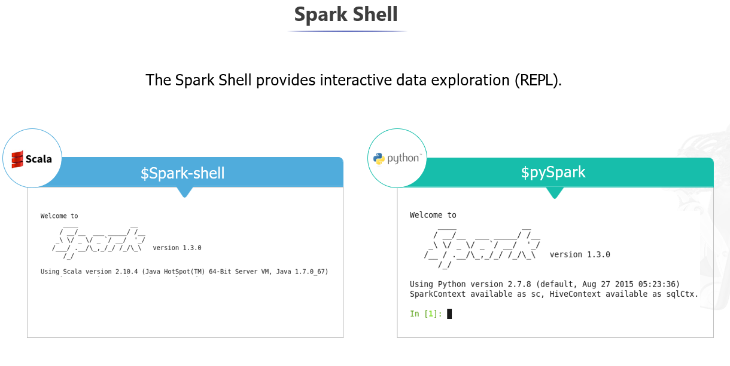

Slide 6
Introduction
Scenario: Analyzing Popular New York Times Articles
Website-> https://developer.nytimes.com/
Extracted relevant unstructured data from the New York Times API using Python and Spark
Tools and technology used: Spark, Anaconda (Jupyter Notebook), Python, Java

Slide 7
DataSet Explanation
The dataset "Analyzing Popular New York Times Articles" contains information about popular articles from The New York Times. It likely includes details such as article titles, authors, descriptions, publishers, and Amazon product URLs. The dataset enables analysis and exploration of popular articles, allowing insights into trends, popular authors, and publishing patterns. By leveraging this dataset, one can gain a better understanding of the characteristics and popularity of articles published by The New York Times.

Slide 8
Data Pipeline Design using Apache Spark:
Tools and technology-> Spark, Anaconda(Jyupter Notebook), Python, Java
Step 1: Launch a Python environment, such as Jupyter Notebook, using Anaconda.
Step 2: Import the required libraries and set up a SparkSession to work with Spark.
Step 3: Make API requests to the New York Times API using the requests library.
Step 4: Convert the Text data into JSON and Parse the JSON responses received from the API and extract the relevant data using Spark Library in Jupyter Notebook.
Step 5: Store the extracted data in an appropriate format (CSV) for further analysis

Slide 9
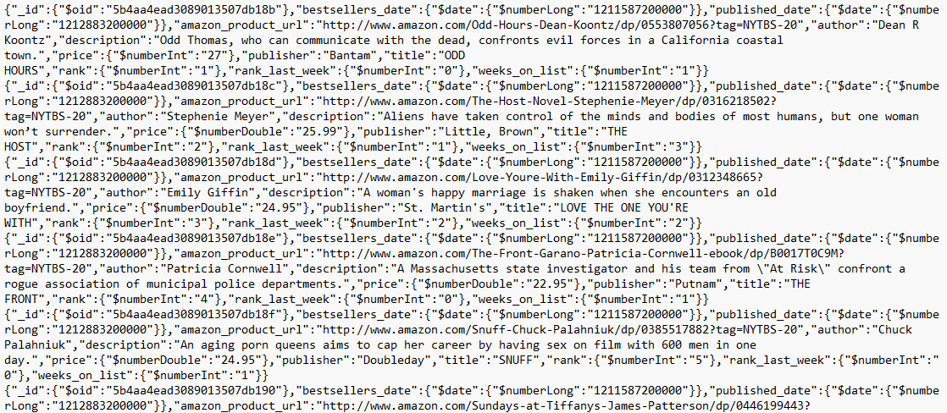
Unstructured Data

Slide 10

Apache Spark With Code Along

Slide 11
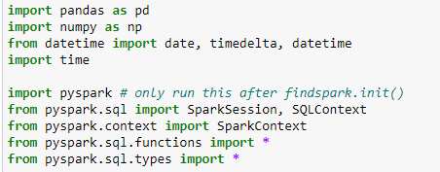
Data Extraction and Analysis Using Code
Import Library of pyspark and pandas

Slide 12
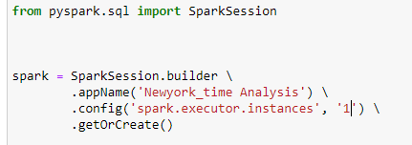
Established a Connection to Spark Cluster
The code creates a SparkSession object named 'spark' with the application name 'Newyork_time Analysis' and configures it to use one executor instance. Where .getOrCreate() this line completes the process of creating a Spark-Session object.

Slide 13

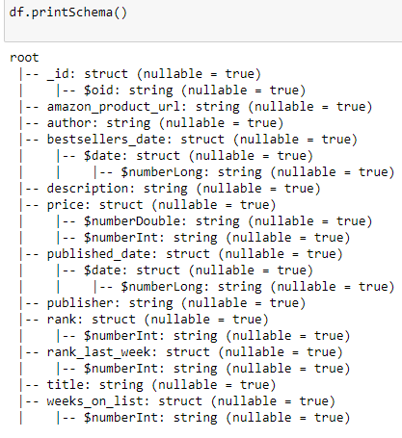
Extract the data and data Frame Schema
The code is displaying the schema of a DataFrame. It shows the structure and data types of each column in the DataFrame. The schema includes information such as column names, nullable status, and nested structures

Slide 14
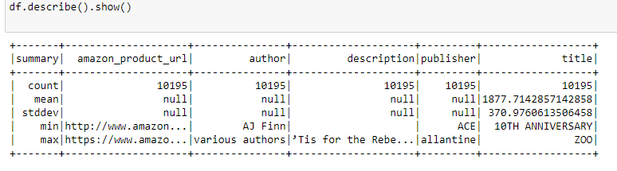
EDA and Feature Engineering Statistical Summary of the Dataset
This summary provides basic statistical information and insights about the dataset, such as the count of non-null values, mean, standard deviation, minimum, and maximum values for each column.

Slide 15
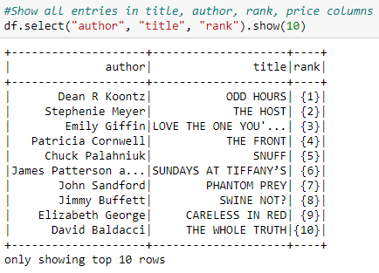
Transform the Data Shows the all ten entries of Title, Author, Rank and price Columns
This code selects the columns "author", "title", and "rank" from the DataFrame "df" and displays the first 10 rows.

Slide 16
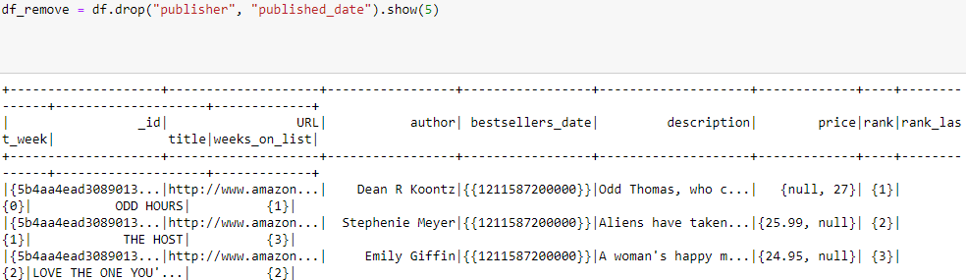
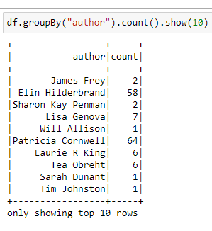
Data Frame Operations
1. The code removes the "publisher" and "published_date" columns from the DataFrame "df" using the drop method. It then shows the first 5 rows of the modified DataFrame.
2. The code groups the DataFrame "df" by the "author" column and calculates the count of each unique author, then displays the first 10 rows of the resulting DataFrame.

Slide 17
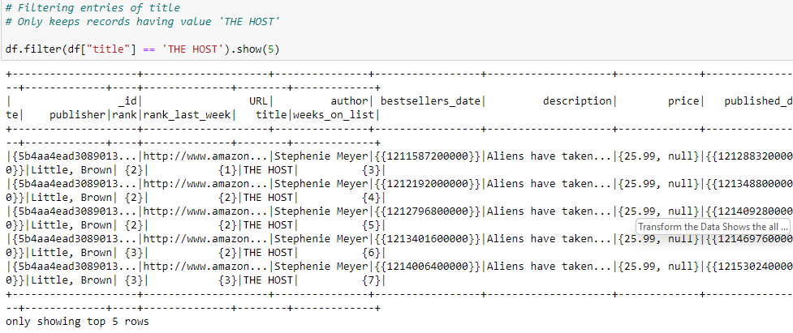
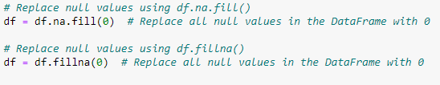
Filtering Entries of the Columns and handling Missing Values
1. The code filters the DataFrame "df" to select only the rows where the value in the "title" column is equal to 'THE HOST', and displays the first 5 rows of the filtered DataFrame.
2.

Slide 18
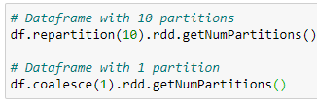
Resilient Distributed Dataset (RDD)
The first line of code repartitions the DataFrame "df" into 10 partitions and returns the number of partitions in the resulting RDD.
The second line of code coalesces the DataFrame "df" into 1 partition (combining all data into a single partition) and returns the number of partitions in the resulting RDD.

Slide 19
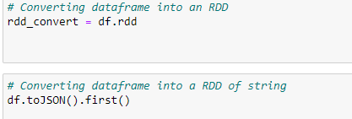
Converting the data Frame in to RDD
The first line rdd_convert = df.rdd converts the DataFrame df into an RDD (Resilient Distributed Dataset), which is a distributed collection of elements that can be processed in parallel.
The second line df.toJSON().first() converts the DataFrame df into a JSON format by calling the toJSON() function and then retrieves the first element of the resulting RDD using the first() function. This will return the first row of the DataFrame in JSON format.

Slide 20
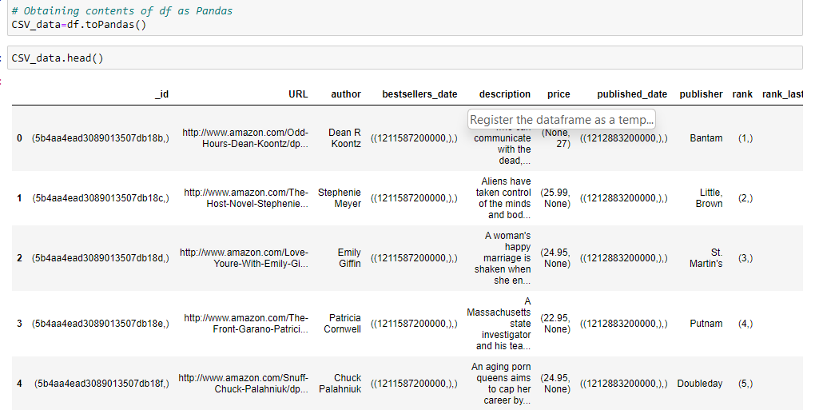
Pandas Data Frame
Convert the data into pandas data frame for further analysis

Slide 21
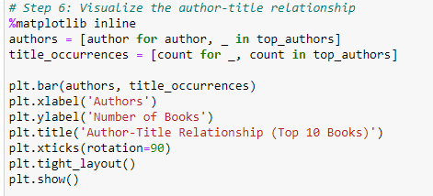
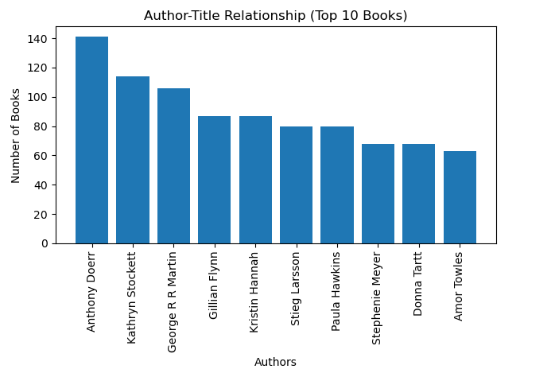
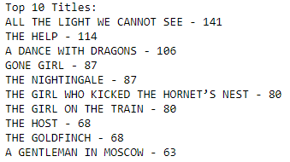
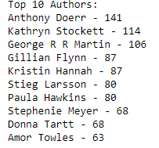
Insights of Data Set

Slide 22
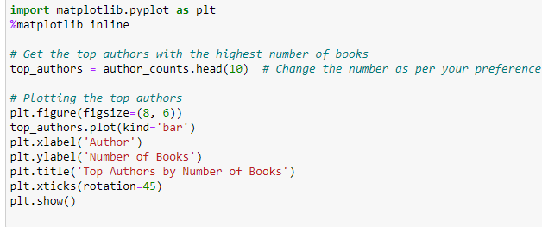
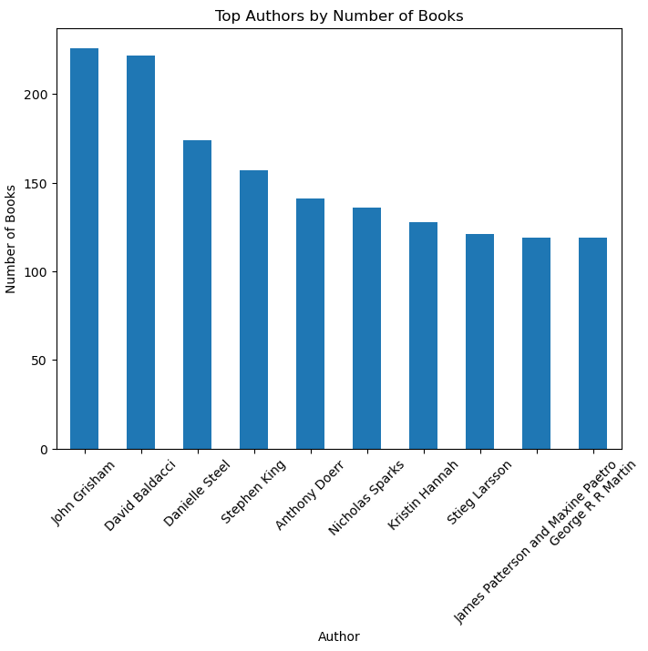
Data Insights-> Top Authors by Numbers of Books

Slide 23
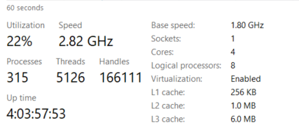
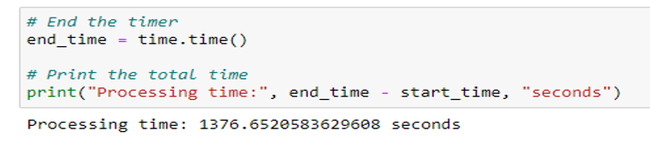
Scalability
Performance of Computer
Total processing time of Instance 1

Slide 24
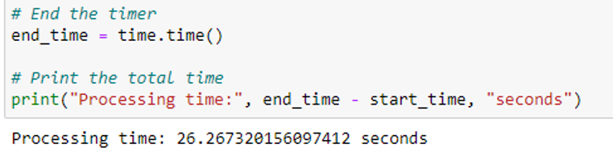
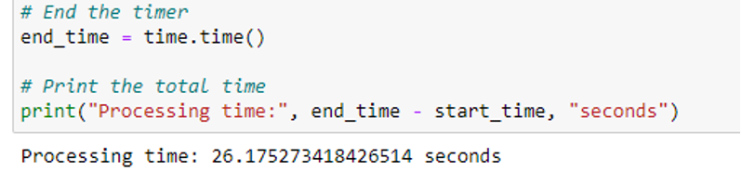
Scalability
Total Processing Time of Instance 2->26.26 Seconds
Total Processing Time of Instance 3-> 26.17 Seconds

Slide 25
Conclusions:
The topmost title in the dataset is "ALL THE LIGHT WE CANNOT SEE" with the topmost author name being "Anthony Doerr". This suggests that "ALL THE LIGHT WE CANNOT SEE" is a popular book in the dataset, and “Anthony Doerr“ is the author associated with it.
Among all the authors in the dataset, “John Grisham” stands out with the highest number of books. He has a total of 250 books associated with his name. This indicates that Anthony Doerr is a prolific author within the dataset, having contributed significantly to the collection of books.
The total processing time of the dataset and analysis on Instance one was 1376.65 seconds, on Instance 2 it was 26.26 seconds, and on Instance 3 it was 26.17 seconds.
This suggests that Instance 1 had the longest processing time, while Instances 2 and 3 were significantly faster.
The difference in processing time across instances indicates variations in computational resources or workload distribution.

Slide 26
Conclusions
Instance 1 might have lower processing capabilities or be overloaded with other tasks, resulting in slower performance. Instances 2 and 3, on the other hand, showed better performance and efficiency. It is important to consider the computational resources and workload distribution when performing data analysis.
In summary, the conclusions highlight the popularity of the book "ALL THE LIGHT WE CANNOT SEE" by Anthony Doerr, the prolific nature of Anthony Doerr's contributions to the dataset, and the significance of selecting appropriate computational resources and optimizing workload distribution for efficient data processing and analysis.

Slide 27
Thank you!

